Slide 1
Employee Data Analysis using Excel
STUDENT NAME: Yuva Shri R K
REGISTER NO : 2213371036158 / unm410100442213371036158
DEPARTMENT: B.COM(GENERAL)
COLLEGE : QUAID-E-MILLATH GOVERNMENT COLLEGE

Slide 2
PROJECT TITLE
Employee Performance Analysis using Excel

Slide 3


AGENDA
Problem Statement
Project Overview
End Users
Our Solution and Proposition
Dataset Description
Modelling Approach
Results and Discussion
Conclusion
3/21/2024 Annual Review

Slide 4

PROBLEM STATEMENT ✓ We have to motivate the employees ✓ We have to track the performance of employees work motive for the organization ✓ We have to train and motivate the under developed employees in a effective manner.

Slide 5

PROJECT OVERVIEW
EMPLOYEE DATA ANALYSIS
Analysing the performance of the employees by considering the various factors like Gender, Performance level, Ratings and their Achievements, in order to identify the trends and patterns of different categories of employees like high, medium and low

Slide 6





WHO ARE THE END USERS?
Notes:
Manager

Slide 7

OUR SOLUTION AND ITS VALUE PROPOSITION
CONDITIONAL FORMATTING - To identify the missing data
FILTER - Removing the unwanted data
FORMULA - Identify the performance level of the employees
PIVOT TABLE - To convert the data into short table
GRAPH - Data visualization

Slide 8
Dataset Description
EMPLOYEE DATA - KAGGLE
26 - FEATURES
9 – FEATURES
EMPLOYEE – ID – NUMERICAL VALUES
NAME – TEXT
EMPLOYEE TYPE
PERFORMANCE LEVEL
GENDER – MALE , FEMALE
EMPLOYEE RATING – NUMERICAL VALUES

Slide 9

THE "WOW" IN OUR SOLUTION
Performance level =IF(Z8>=5,”VERY HIGH”,(Z8>=4,”HIGH”,(Z8>=3,”MEDIUM”,”LOW”)))
3/21/2024 Annual Review
9

Slide 10
MODELLING
DATA COLLECTION
✓ Downloaded the employees data from edunet dashboard
FEATURE COLLECTION
✓ Identifed Each features and add performance level features
DATA CLEANING
✓ Identify the missing values and filtered the missing values
PERFORMANCE LEVEL
✓ Performance level formula =IF(Z8>=5,”VERY HIGH”,(Z8>=4,”HIGH”,(Z8>=3,”MEDIUM”,”LOW”)))
SUMMARY
✓ PivotTable
✓ Pie chart
VISUALIZATION
✓ Graph
✓ Pie chart
10

Slide 11
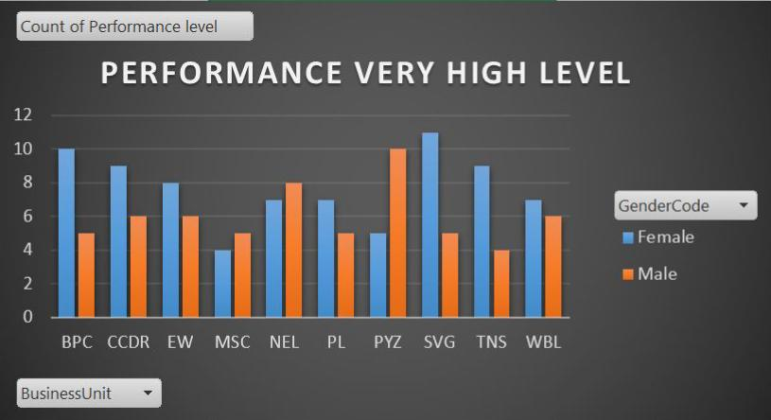
RESULTS
11

Slide 12
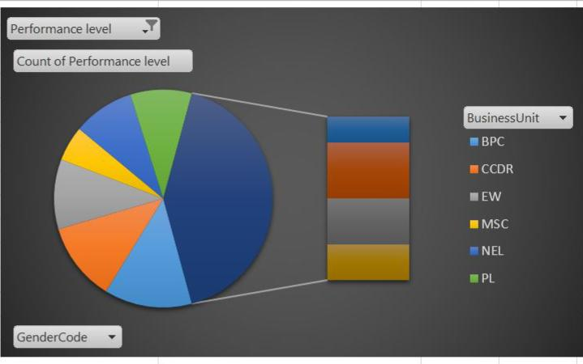
RESULTS

Slide 13
conclusion
✓ BY COMPARING THE PERFORMANCE OF THE EMPLOYEES. THE EMPLOYEES ARE HIGHER IN NUMBER. THERE ARE MORE PEOPLE IN AVERAGE LEVEL EMPLOYEES. ✓ WE HAVE TO MOTIVAYE THE EMPLOYEES TO DEVELOP THEIR SKILLS AND TALENTS. TO ACHIEVE THE ORGANISATIONAL GOALS AND OBJECTIVES TO REACH THE PLACE OF HIGH LEVEL PERFORMANCE TO SUSTAIN THE GOALS AND TARGETS. ✓ WE HAVE TO TRAIN AND DEVELOP THE EMPLOYEES WITH BETTER OUTCOME TO REACH THE ORGANISATIONAL GOALS

